Slide 1
A Reflectionless Filter for Load-pull Measurements: Design, Simulation & Experimental Characterization
Senior Design Project
Robert Valois
Olasubomi Borishade
Eli Gabaldon
Faculty Advisor: Dr. Hung Luyen

Slide 2
Overview
Problem Identification
Intro to Reflectionless Filters
Specifications & Requirements
Realistic Constraints
Ethical & Professional Issues
Contemporary Issues
Engineering Standards
Design
Simulation
Fabrication
Testing
Future Implementations
Teamwork Distribution
Acknowledgments
References

Slide 3
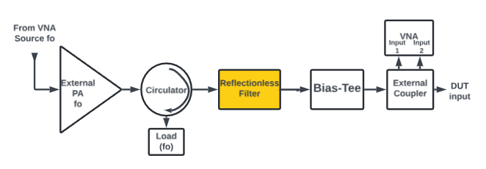
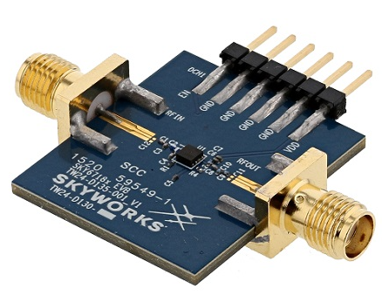
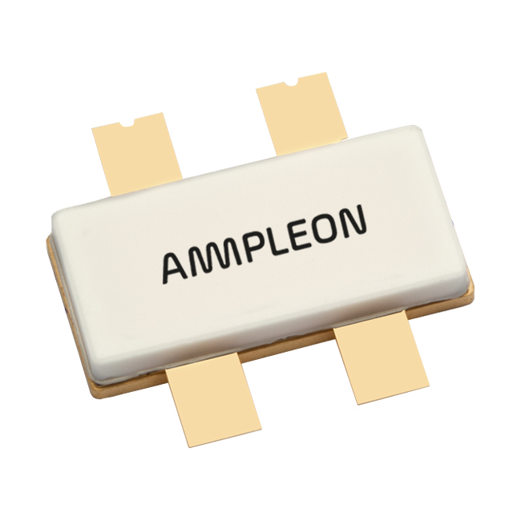
Problem Identification
RF device manufacturers demand high accuracy in characterizations of their investments (i.e. devices under test, DUT) for modelling and performance.
Load-pull test setups provide DUT characterization.
Problem: DUT characterization is threatened by band-limited components which cause unwanted oscillations during active load-pull measurement setups.
Figure 3: RF Power transistor for industrial applications
Figure 2: LNA for LTE and 5G applications
Figure 1: Front end of active load-pull test setup
“Skyworks Introduces High Gain LNA for Small Cell, Cellular 5G NR, & Base Station Applications,” Everythingrf.com, Mar. 18, 2021. https://www.everythingrf.com/news/details/11955-skyworks-introduces-high-gain-lna-for-small-cell-cellular-5g-nr-base-station-applications (accessed Nov. 01, 2024).
Ampleon. Broadband power LDMOS transistor. Product Data Sheet. Sept 2015.

Slide 4
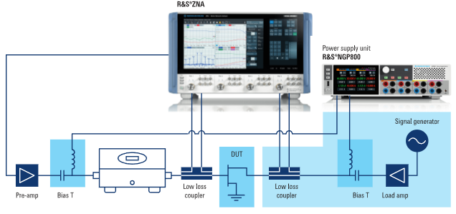
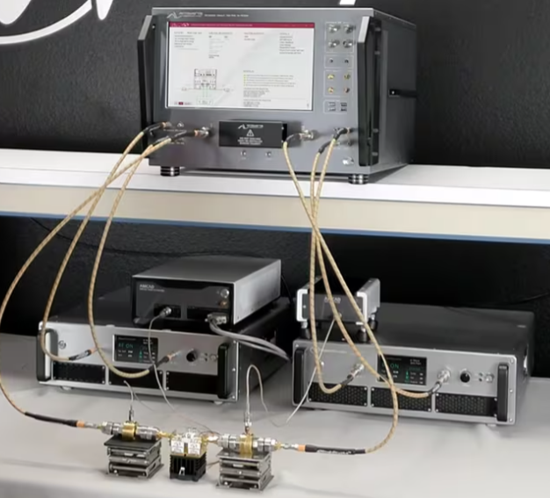
Active Load-Pull Test Setups
Load-pull measurements characterize by observing a DUTs reaction to impedance tunings.
Impedance is tuned by the varying the phase and magnitude of source signals injected to both ports of a DUT.
Figure 2: Rhode & Schwarz active load-pull setup
Figure 1: Maury Microwave active load-pull setup
SDC9 - Reflectionless High-pass Filter Design for Load-Pull Measurement Setups. IEEE IMS TC-3 Microwave Measurements Committee, TC5-Filters Committee, 2024
“Measurement & Modeling Device Characterization Solutions Non-50ohm Measurements.” Available: https://maurymw.com/wp-content/uploads/2023/11/5A-062.pdf

Slide 5
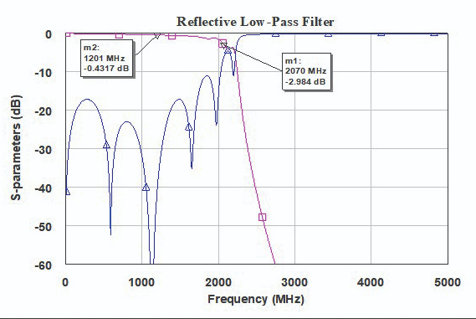
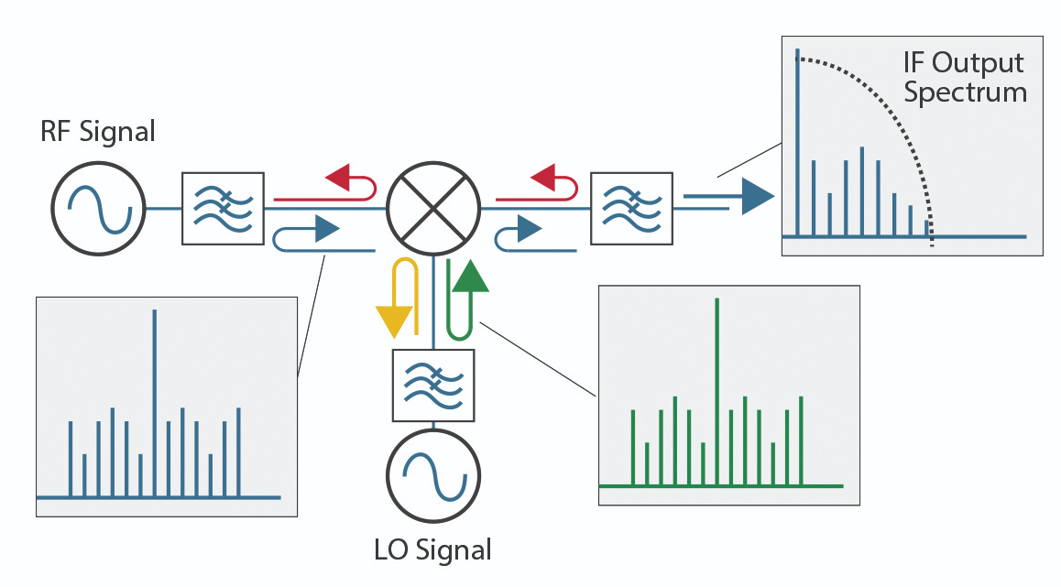
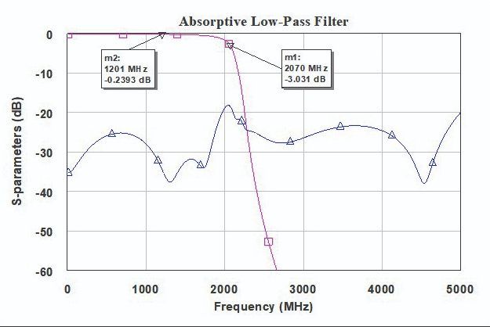
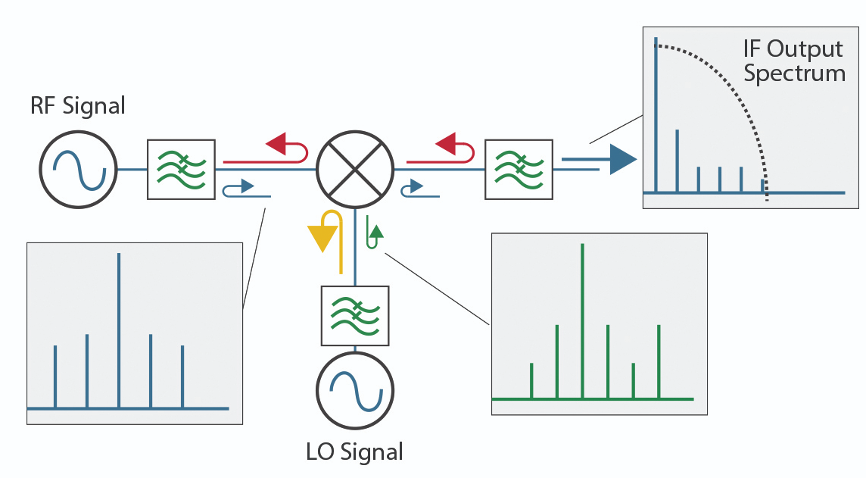
Introduction to Reflectionless Filters
Solution: A practical filter that can absorb reflected signals within the load-pull setup’s signal chain.
Reflection in stopband
Reflections in stopband = distorted modulation
Absorbed reflections in stopband = cleaner modulation
Absorbed reflection
Werlatone, “Be a Team Player: Use Absorptive (Reflectionless) Filters,” Microwave Product Digest, Jun. 21, 2021. https://www.mpdigest.com/2021/06/21/be-a-team-player-use-absorptive-reflectionless-filters/ (accessed Nov. 12, 2024).

Slide 6
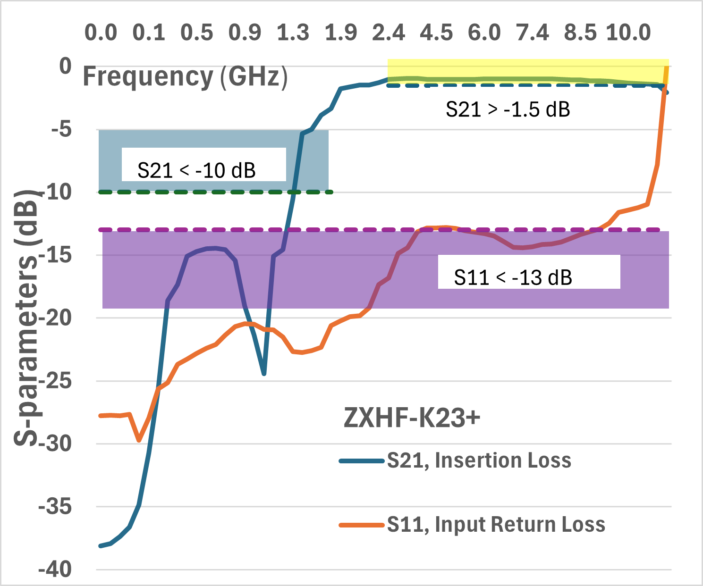
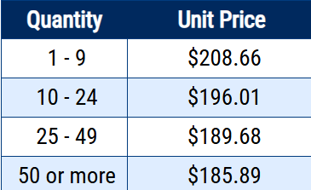

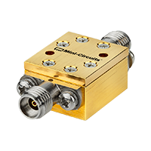
Commercial Availability of Reflectionless Filters
Roll-off not steep enough
Return loss too high
Reflectionless High Pass Filter, 2010 - 10100 MHz | ZXHF-K23+ | Mini-Circuits. (2017). Minicircuits.com. https://www.minicircuits.com/WebStore/dashboard.html?model=ZXHF-K23%2B
‌

Slide 7
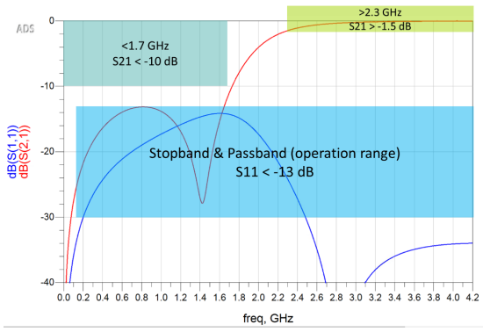
Specifications & Requirements
Any substrate materials and passive components (ceramic, multi-layer, etc.)
Connectors should be Female type and suitable for 3.5 mm Male cable connections (such as 2.92 mm, 3.5 mm, or SMA)
Total area of the designs <= 300 cm²
No active components, such as transistors or ICs are allowed. There should not be any biasing requirement or battery (or supercapacitor) connected
High-pass topology required to suppress low-freq reflections from circulators
Figure 1: S-parameter specifications for high-pass filter
SDC9 - Reflectionless High-pass Filter Design for Load-Pull Measurement Setups. IEEE IMS TC-3 Microwave Measurements Committee, TC5-Filters Committee, 2024

Slide 8
Realistic Constraints
Simulation software
Approximation of component values going from ideal to the manufacturer’s catalogue
Personal backgrounds: Introductory level knowledge of filter topology, transmission line theory, RF testing, RF simulation, PCB design, PCB fabrication, etc.
Budget
Limited to purchase of one PCB design due to fabricator’s restrictions
Limited to assembly of one PCB due to component costs
Assembled manually to avoid fabricator’s fee
Prototype
Size of PCB >= 50x50mm (JLCPCB)
PCB layers: Limited to 1 layer for cost and complexity
Lumped vs distributed: Lumped chosen to reduce complexity
Components: Self-resonant frequencies must be >> 6 GHz
Microstrip length <= 1 mm to limit losses
Cost Analysis | JLCPCB | PCBWay
Components (inductors, capacitors, resistors, connectors) | $34 | $34
PCB fab (board, stencil, solder paste, shipping) | $140 | $354
Total | $174 | $388
Final budget | -$24 | -$238
PCB design software
Altium chosen due to ubiquity in industry
M. A. Morgan. Reflectionless Filters. Norwood, MA: Artech House, 2017

Slide 9
Ethical & Professional Issues
Consumer safety
Material safety - RoHS compliant parts and lead-free
Environmental impact
Chose environmentally friendly components where possible
Product reliability and performance
SMA connectors have 500 mating cycles
Passive components shelf-life app. 1 year
Material sourcing
Conflict-free or in pursuit – Murata hasn’t declared
Components are easily replaceable
Procurement is sensitive to disruptions in global supply chain
CONSMA003. 031-G TE, “TE Connectivity CONSMA003.031-G,” Mouser Electronics, 2024. Available: https://www.mouser.com/ProductDetail/TE-Connectivity-Linx-Technologies/CONSMA003.031-G?qs=vLWxofP3U2x2%252BzzRme2ncQ%3D%3D.
Vishay Material Category Policy‌. June 15, 2016
“Related material of environment | Ceramic Capacitor | Murata Manufacturing Co., Ltd.,” Murata Manufacturing Co., Ltd., 2024. Available: https://www.murata.com/en-us/products/capacitor/ceramiccapacitor/documents/certificate.
“US8392495B2 - Reflectionless filters - Google Patents,” Google.com, Jun. 02, 2009. Available: https://patents.google.com/patent/US8392495B2/en. ‌
‌
Intellectual property
Patent outlines the filter’s derivation.
Academic use of the patent is allowed, and permission would be required for commercial use.

Slide 10
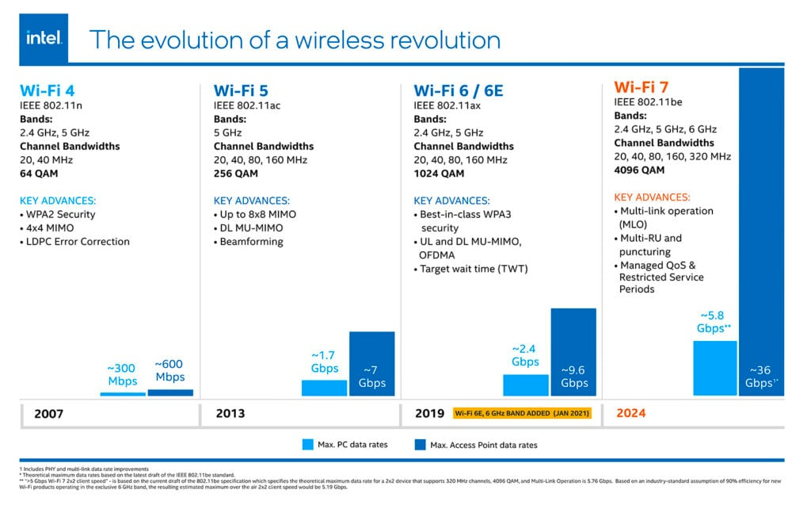
Contemporary Issues
The 2.4 to 6 GHz BW will be the standard.
Investment into devices that use this BW will continue therefore investment into their improvement is critical.
Thus, RF engineers need improved/varied tools to optimize wireless communications devices.

Slide 11



Engineering Standards
Standard | Description | Application | Datasheets reported in
IPC-2221 | PCB guidelines for layout, materials, and fabrication | Microstrip implementation
IPC-TM-650 | Test methods to simulate exposure to the thermal conditions by convection reflow assembly and properties of dielectric materials | PCB assembly | Rogers 4035B
UL-94 | Indication of flame retardancy level of a material | PCB | Rogers 4035B
MIL-STD-202 | Enviornmental testing standards | Ruggedness under stressful conditions | Vishay, Murata, SMA conn
MIL-STD348A | Specifies dimensions, configurations, and tolerances for SMA connectors | Military and aerospace | SMA conn
AEC-Q200 | Ensure compatibility and reliability of passive components | Automotive electronics | Murata
ASTM B-117 | Specifies testing for resistance to corrosion of coatings and materials | Automotive, aerospace, construction, and marine | SMA conn
ANSO/ESD-STM | Outlines test methods and performance criteria for mitigating ESD in components electronics manufacturing, semiconductor design, aerospace, and telecommunications | electronics manufacturing, semiconductor design, aerospace, and telecommunications | Mini-Circuits
Scattering parameters | Characterization of RF device performance (i.e. signal reflection and transmission) | Resistors, filters, amplifiers, antennas, and connectors | Mini-Circuits
IEEE 802.11 be / Wi-Fi 7 | Technical standards that define the protocols for wireless comms | 2.3 -6 GHz

Slide 12
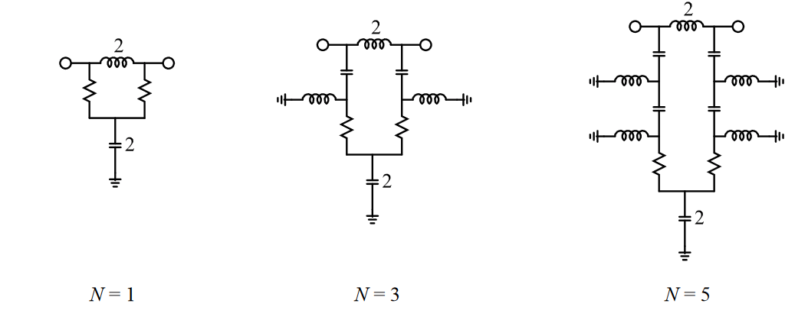
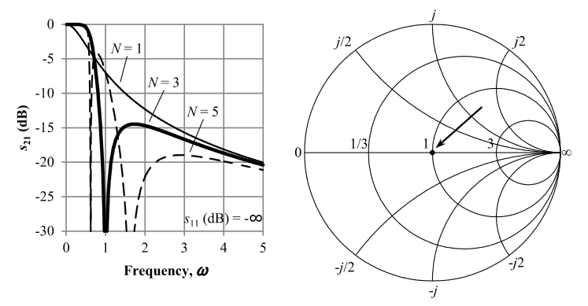
Basic Reflectionless Filter
Topology: Matthew Morgan's Basic Reflectionless Filter References:
Morgan's book and patent detail the topology, its derivation, and customization techniques.
Reflectionless Filters by Matthew Morgan
Matthew Morgan's Reflectionless filter patent US 8,392,495 B2.
Description:
Chebyshev Type II response
Theoretically infinite return loss
Constant real impedance across all frequencies
Matthew Morgan's Basic Low-Pass Reflectionless Filter First Order, Third Order and Fifth Order
M. A. Morgan. Reflectionless Filters. Norwood, MA: Artech House, 2017.

Slide 13
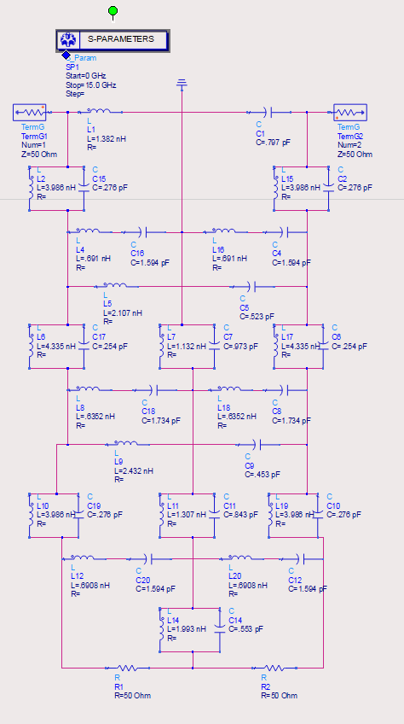
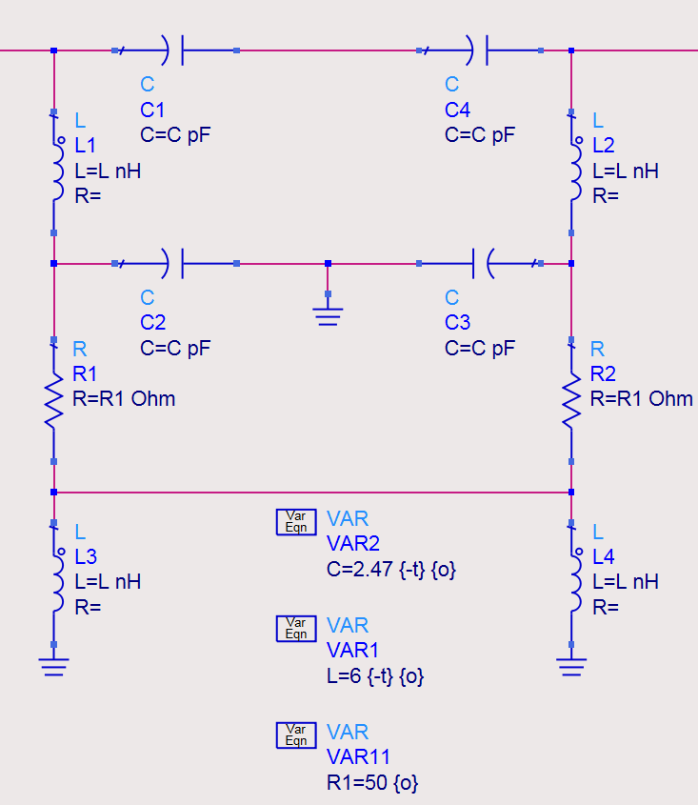
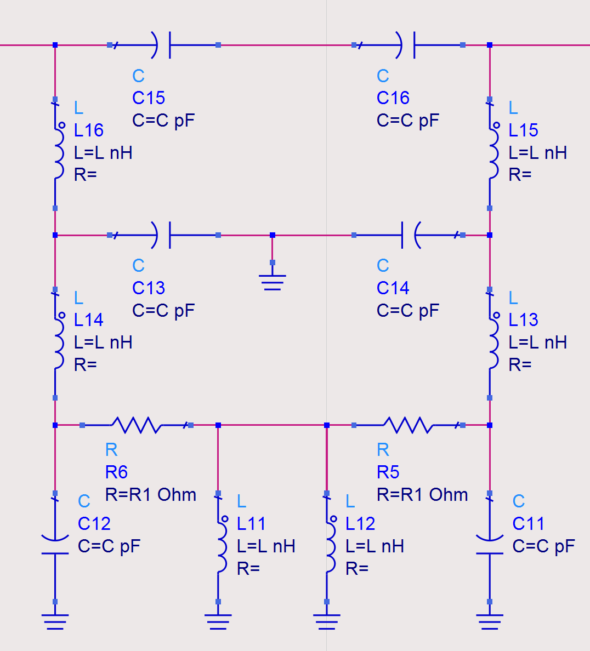
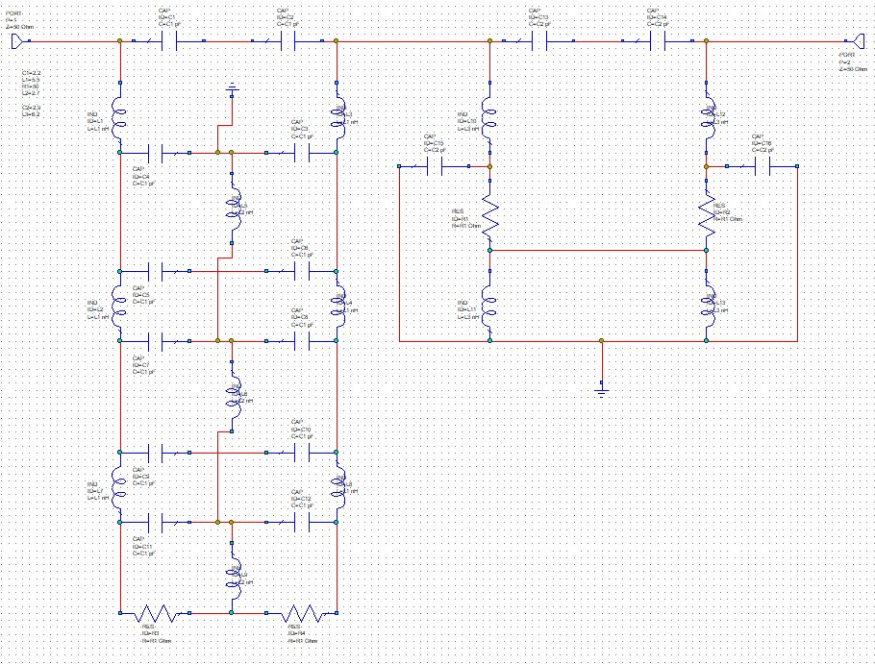
Preliminary Designs
Compound
Third Order High-Pass
Fifth Order High-Pass
Compound Reflectionless Filter Casscade

Slide 14
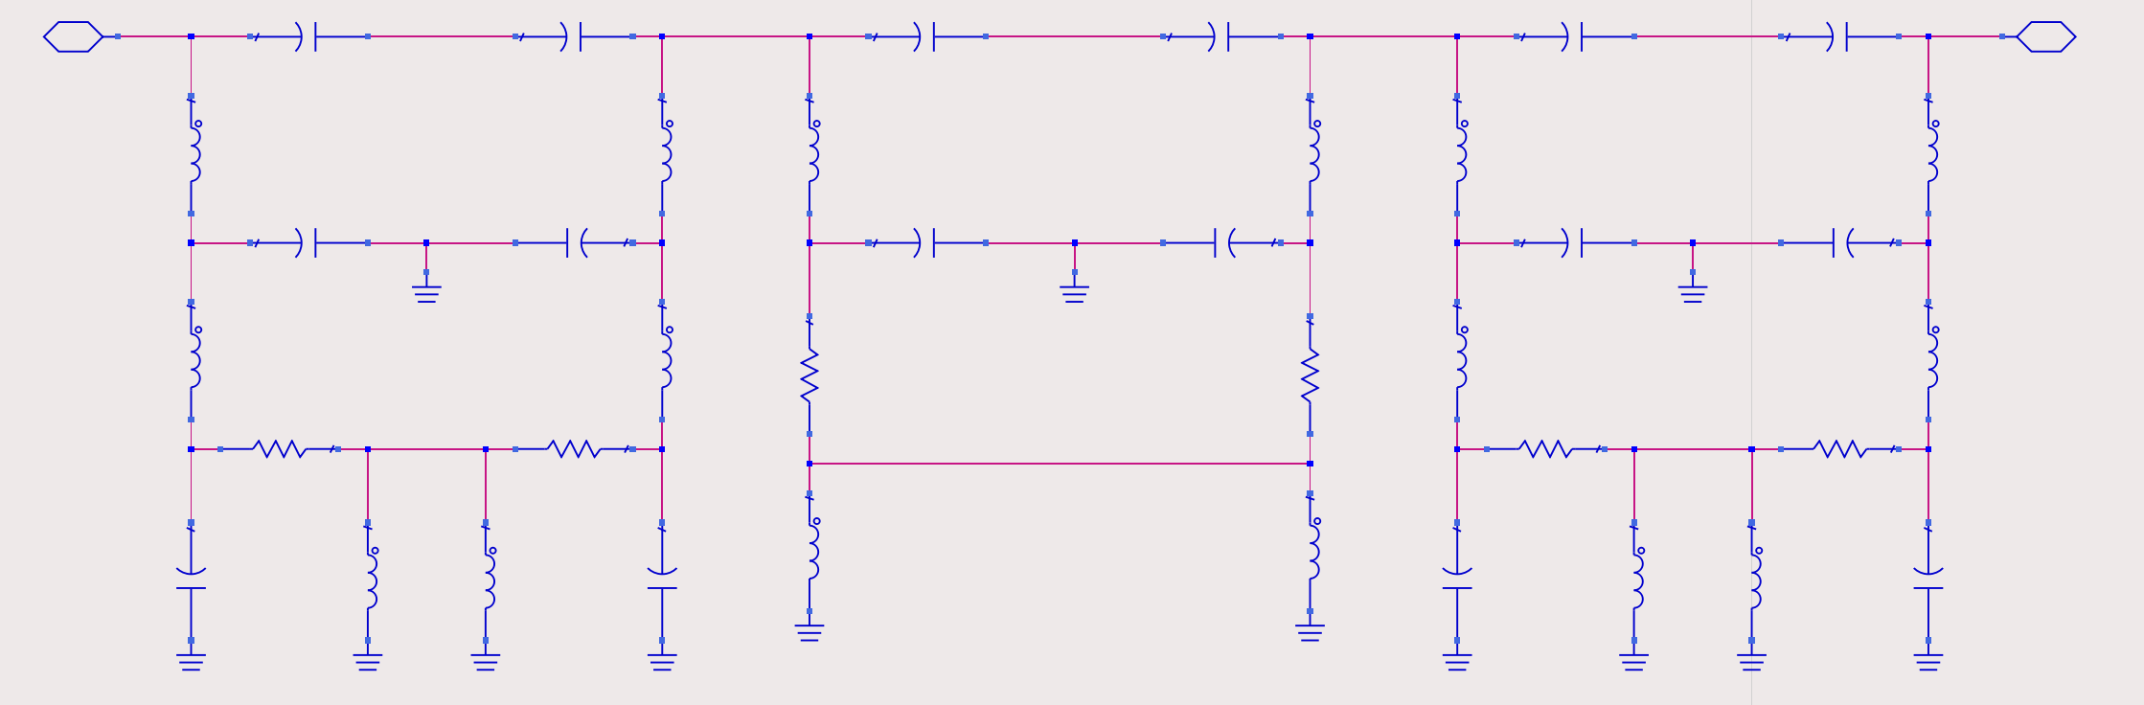
Symmetrical Cascade
N = 5
N = 3
N = 5
Symmetrical design (S21 = S12, S11 = S22)
Minimize transmission line length
2-Layer PCB
Ideal Fifth Order, Third Order, Fifth Order Reflectionless High-Pass Filter

Slide 15
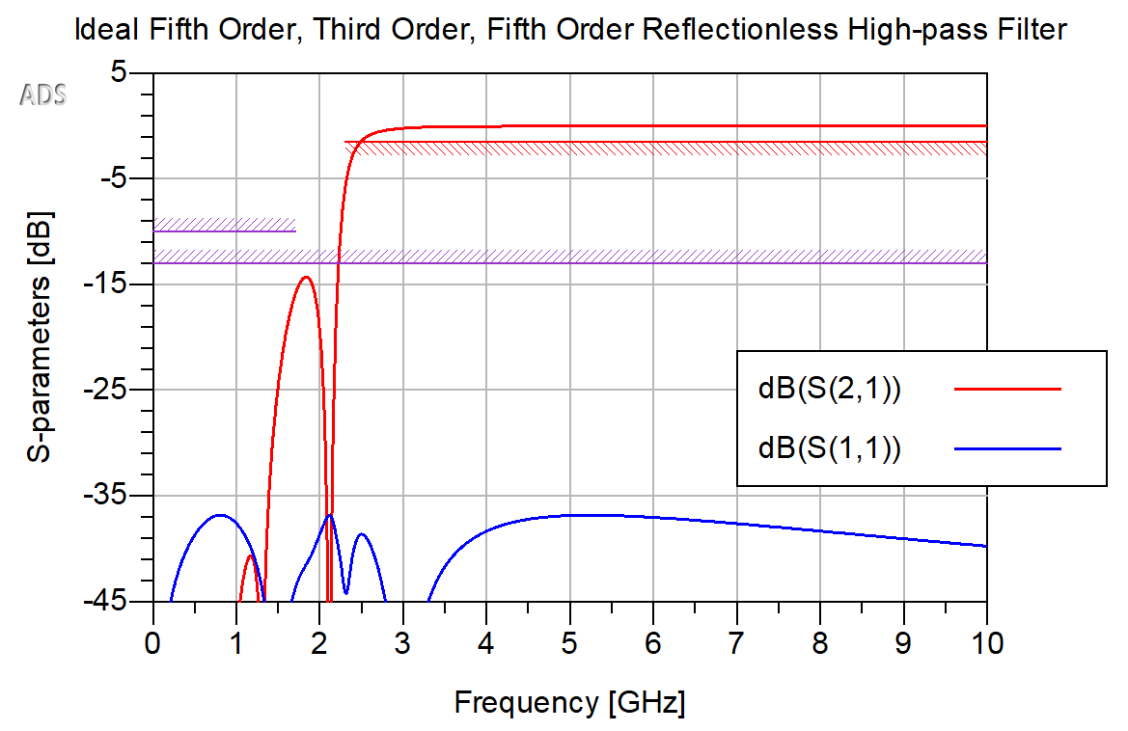
Cascade Simulation
Suppressed reflection
Third order ripple characteristic
Fifth order roll-off characteristic
Cutoff frequency shifted due to cascade
Ideal Fifth Order, Third Order, Fifth Order Reflectionless High-Pass Filter ADS Simulation

Slide 16
Substrate & Component Selection
FR4:
Inexpensive
Made by many manufactures all with different dielectric constants and dissipation factors.
Rogers RO4000 series:
More expensive than FR4.
Designed for high frequency circuits.
Low dielectric constant across wide frequency range
Low dissipation factor
Rogers RO4350B best option with our budget.
Connectors:
SMA (DC – 18 GHz frequency range)
Edge mounted
Murata LQW and LQG series inductors and Murata GJM series capacitors:
Designed for high frequency circuits.
Large library of ADS models.
Properties to consider:
Package size (Used 0402 mm)
Q factor
Self-resonant frequency

Slide 17
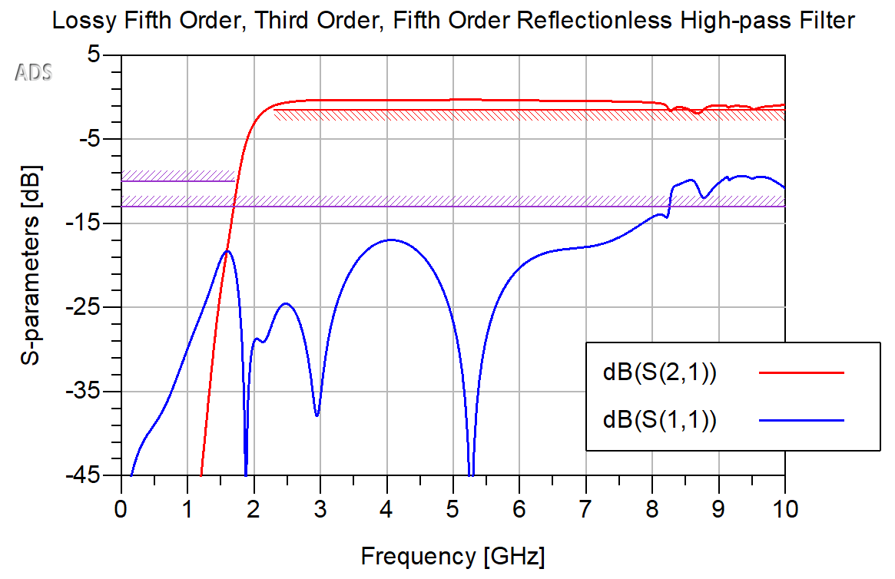
Schematic Simulation with Lossy Transmission Lines and Vendor Component Models
Meets design specifications
DC – 8.25 GHz operating range
Lossy Fifth Order, Third Order, Fifth Order Reflectionless High-Pass Filter ADS Schematic Simulation

Slide 18
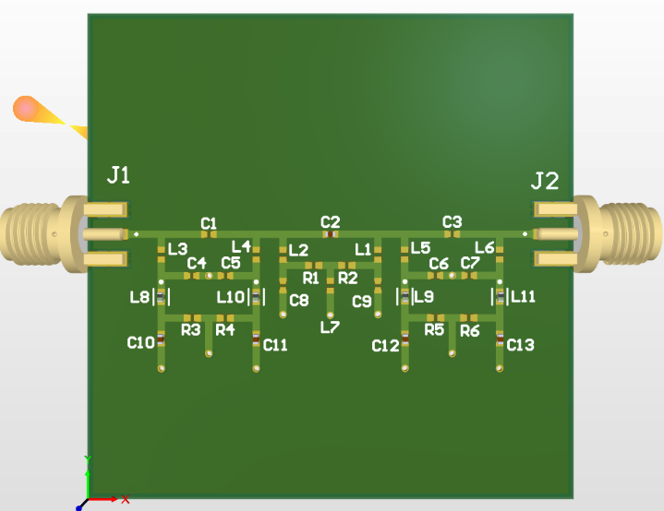
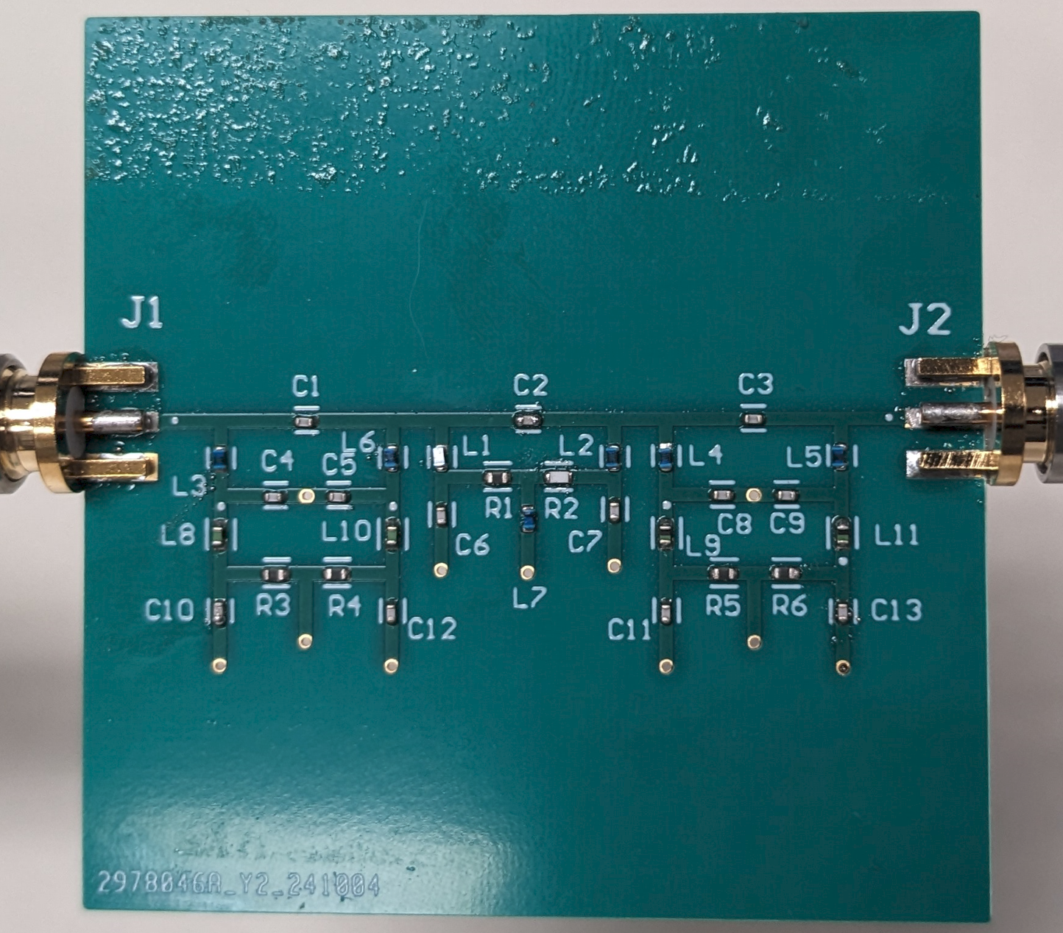
Filter Fabrication Steps
Layout made using Altium Designer.
Layout files exported from Altium and sent to PCB manufacture.
SMD components ordered.
Two prototype filters assembled using the reflow oven in the UNT Senior Design Lab.
Altium Designer Layout
Assembled Prototype

Slide 19
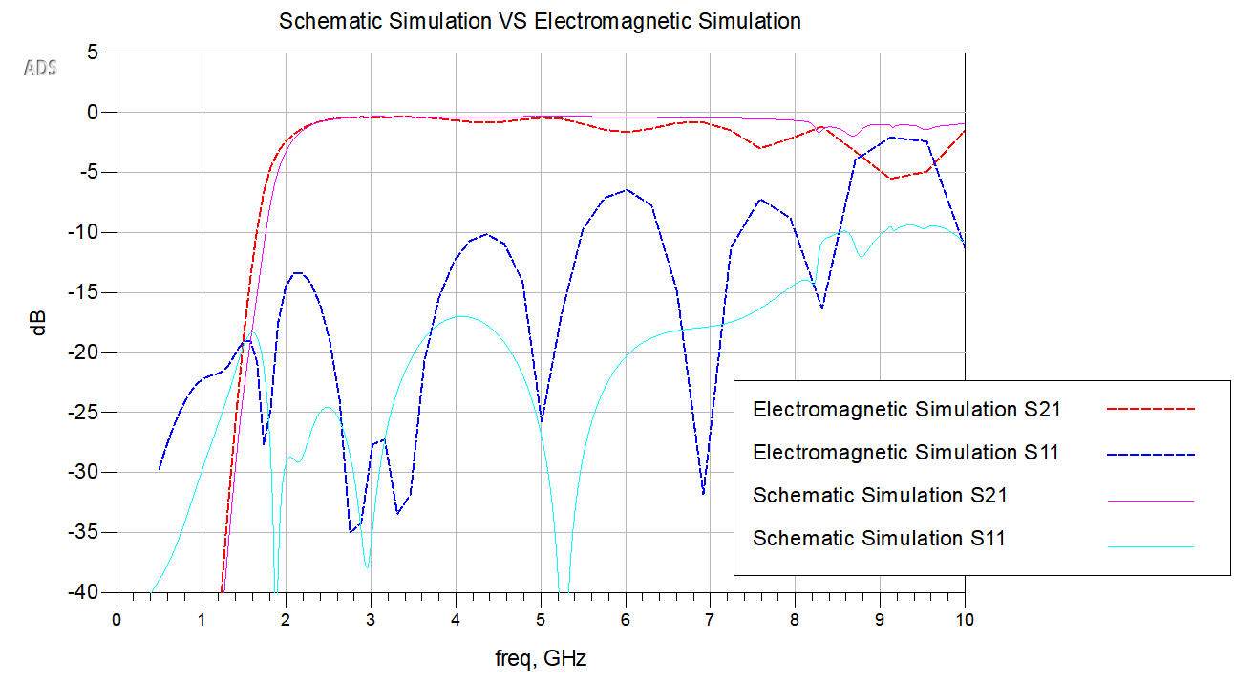
EM Simulation
Accounts for 3D structure of transmission lines
Cut-off frequency shifted lower
Increased insertion loss
More reflection
Schematic Simulation vs Electromagnetic Simulation

Slide 20
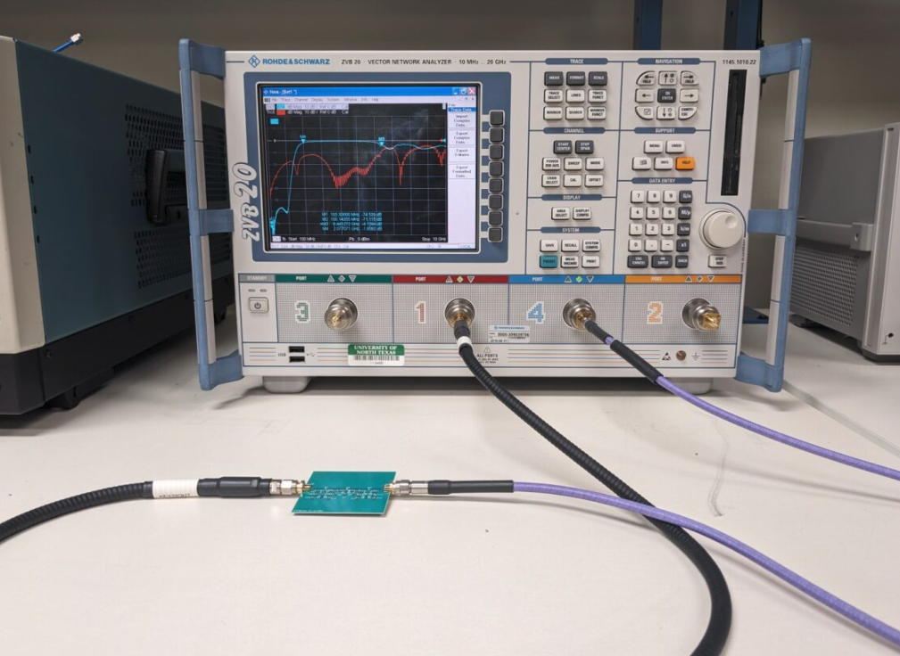
Testing
Tested both prototypes using a Rohde & Schwarz ZVB 20 VNA
Sweep from 100 MHz to 10 GHz collecting s-parameters in 3.3 MHz increments (3000 frequency points).
0 dBm input power
Test Setup

Slide 21
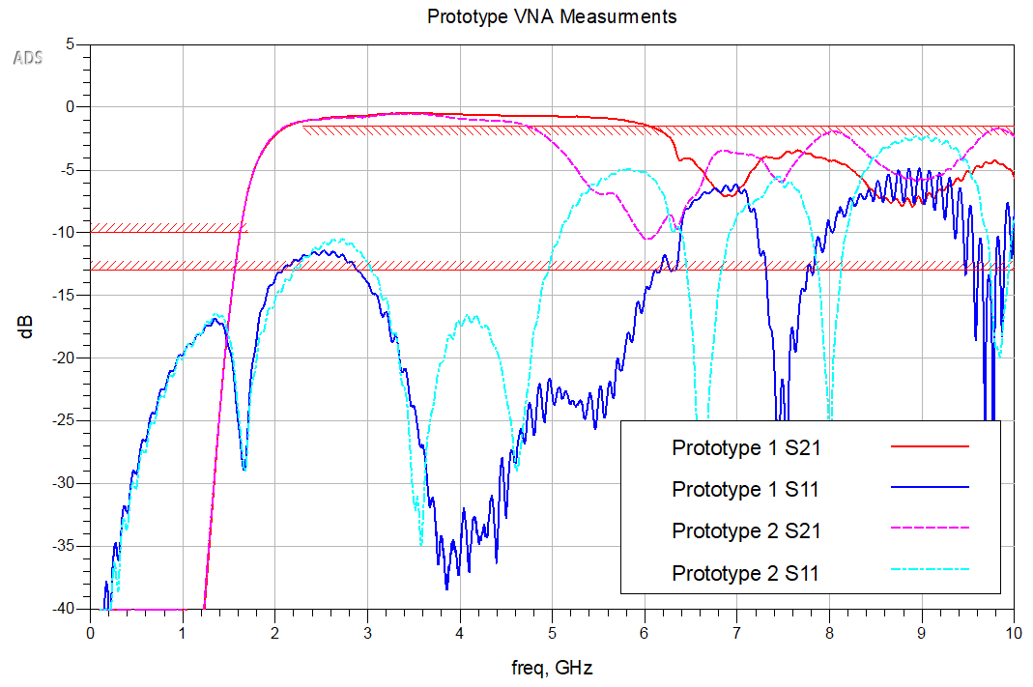
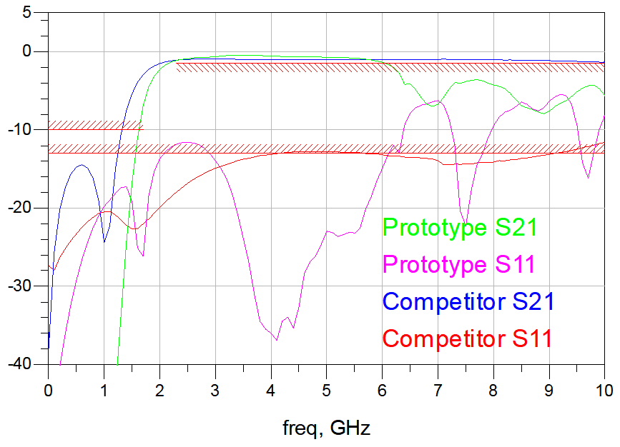
Testing Results
Positives:
Has the shape of a high-pass filter
Suppressed reflection
Filter cutoff closer to design specification than nearest comparable commercially available product.
Needs Improvement:
Does not meet design specifications.
DIY assembly greatly affected the results at higher frequencies.
Could have been improved if EM simulation was completed before fabrication.
Prototype 1 and 2 VNA Measurements
dB
Prototype 1 vs Mini-Circuits KXHF-K23+

Slide 22
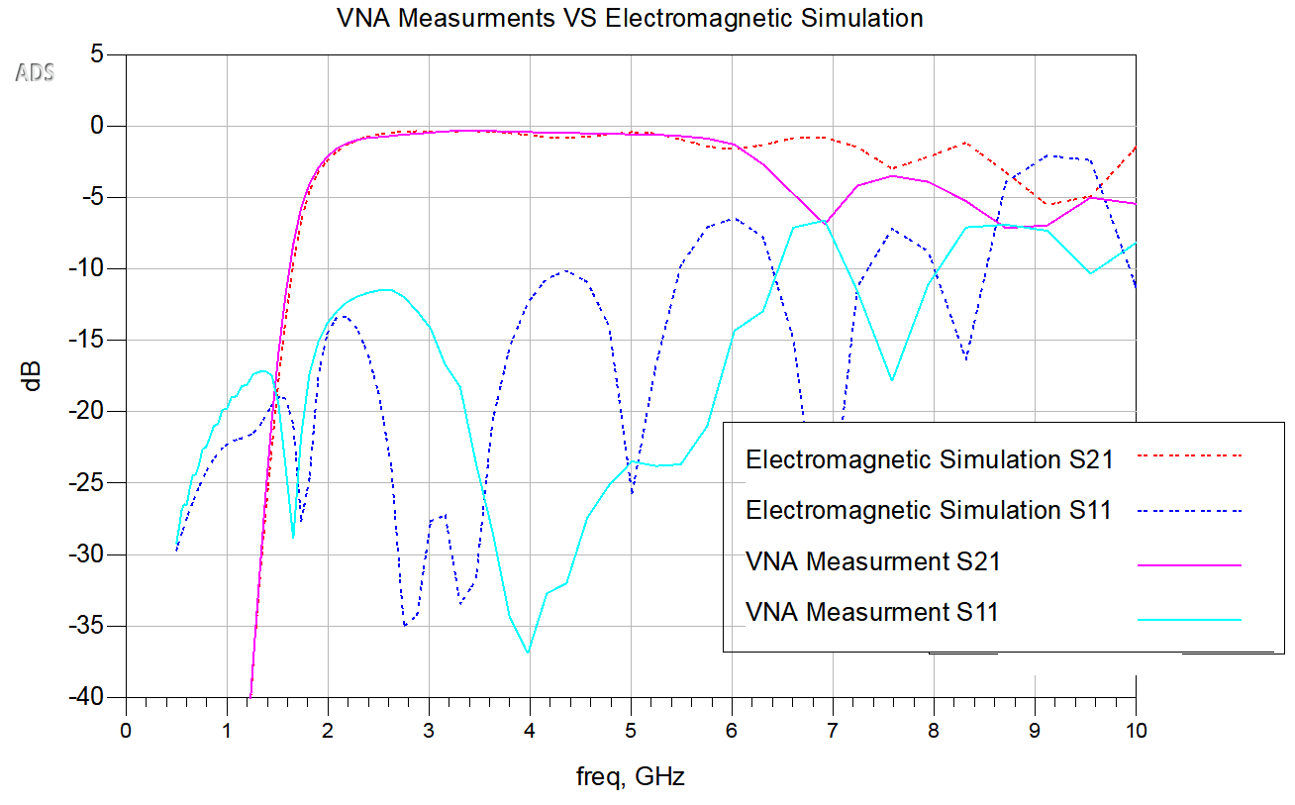
Measurements vs EM Simulation
EM simulation accurately predicted cut-off frequency shift and increased reflection
VNA Measurements vs EM Simulation

Slide 23
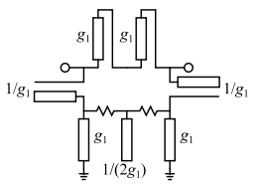
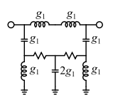
Future Implementations
Opportunities to improve:
Parasitic effects of low Q and self-resonant reactive components (i.e. inductors)
Too many reactive components
Goals:
S11 and S22 need to be brought down within spec.
Pass-band needs to be extended.
Decrease cost
Parameters
Fixed: Frequency specifications, passive elements, size
Variable: substrate material, component values, filter type (i.e. bandpass)
Proposition: Transform design from lumped to distributed elements.
Pros: Discrete inductors eliminated and significant cost reduction
Cons: Transformation is approximation, R&D time investment, larger surface area
Transformation

Slide 24
Work Distribution
Research | All
Designs | All, Robert (champion design)
Simulations | Robert, Olasubomi
CAD | Eli
PCB assembly | Robert, Eli
Testing | All

Slide 25
Acknowledgments
Dr. Hung Luyen
Son Vu
Dr. Shengli Fu
UNT Department of Electrical Engineering Administrative Staff

Slide 26
References
“Skyworks Introduces High Gain LNA for Small Cell, Cellular 5G NR, & Base Station Applications,” Everythingrf.com, Mar. 18, 2021. https://www.everythingrf.com/news/details/11955-skyworks-introduces-high-gain-lna-for-small-cell-cellular-5g-nr-base-station-applications (accessed Nov. 01, 2024).
Ampleon. Broadband power LDMOS transistor. Product Data Sheet. Sept 2015.
SDC9 - Reflectionless High-pass Filter Design for Load-Pull Measurement Setups. IEEE IMS TC-3 Microwave Measurements Committee, TC5-Filters Committee, 2024
“Measurement & Modeling Device Characterization Solutions Non-50ohm Measurements.” Available: https://maurymw.com/wp-content/uploads/2023/11/5A-062.pdf
“MT1000 and MT2000 - Mixed-Signal Active Load Pull System (1.0 MHz to 67.0 GHz) And MT2001 System Software.” Accessed: Nov. 01, 2024. [Online]. Available: https://maurymw.com/wp-content/uploads/2023/11/4T-097.pdf
“Load-Pull Analysis for Optimizing PA Performance Featuring Cadence AWR Software.” Accessed: Oct. 30, 2024. [Online]. Available: https://community.cadence.com/cfs-file/__key/communityserver-blogs-components-weblogfiles/00-00-00-01-21/8156.Load_2D00_pull_5F00_analysis_5F00_optimizing_5F00_PA_2D00_performance_5F00_wp.pdf
Werlatone, “Be a Team Player: Use Absorptive (Reflectionless) Filters,” Microwave Product Digest, Jun. 21, 2021. https://www.mpdigest.com/2021/06/21/be-a-team-player-use-absorptive-reflectionless-filters/ (accessed Nov. 12, 2024).
SDC9 - Reflectionless High-pass Filter Design for Load-Pull Measurement Setups. IEEE IMS TC-3 Microwave Measurements Committee, TC5-Filters Committee, 2024
M. A. Morgan. Reflectionless Filters. Norwood, MA: Artech House, 2017
CONSMA003. 031-G TE, “TE Connectivity CONSMA003.031-G,” Mouser Electronics, 2024. Available: https://www.mouser.com/ProductDetail/TE-Connectivity-Linx-Technologies/CONSMA003.031-G?qs=vLWxofP3U2x2%252BzzRme2ncQ%3D%3D.
Vishay Material Category Policy‌. June 15, 2016
“Related material of environment | Ceramic Capacitor | Murata Manufacturing Co., Ltd.,” Murata Manufacturing Co., Ltd., 2024. Available: https://www.murata.com/en-us/products/capacitor/ceramiccapacitor/documents/certificate.
“US8392495B2 - Reflectionless filters - Google Patents,” Google.com, Jun. 02, 2009. Available: https://patents.google.com/patent/US8392495B2/en. ‌
What Is Wi-Fi 7? (2023). Intel. https://www.intel.com/content/www/us/en/products/docs/wireless/wi-fi-7.html

